Slide 1

🍇 Fruit & Vegetable Classifier
👨‍🎓 Team Members:
Bishop Roy
Reg.no: 0562220005101201
Abid Khan
Reg.no: 0562210005101012

Slide 2

Motivation
Image classification is widely used in AI
Manual recognition is time-consuming
or error-prone
Automating classification saves time
& improves accuracy
Helpful for farmers, vendors, and
food apps

Slide 3

Objectives
Train a model to classify 36 types of fruits & vegetables
Build a user-friendly web app using StreamLit
Predict labels with confidence
Create a clean and functional UI

Slide 4

Dataset & Preprocessing
36 categories (apple, banana, etc.)
Images resized to 180x180
Normalized pixel values
Augmentation and label encoding applied

Slide 5

Model Architecture
CNN using Keras Sequential API
Conv2D → Max-Pooling
→ Dropout
Flatten → Dense → SoftMax
Output: Multiclass classification

Slide 6

Training & Evaluation
Optimizer: Adam
Loss: Categorical Cross-entropy
Metrics: Accuracy, F1-Score
Evaluation via confusion matrix

Slide 7
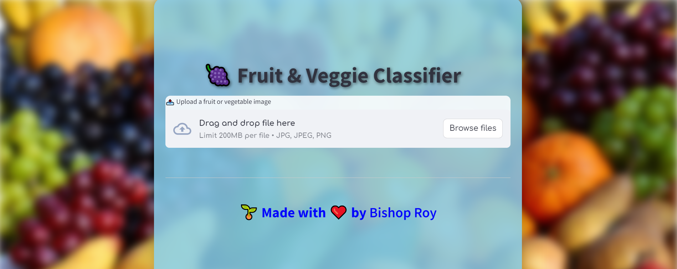
Web App Using StreamLit
Upload image (.jpg, .png)
Predict fruit/veggie name
Show confidence %
Clean UI with background & styling

Slide 8

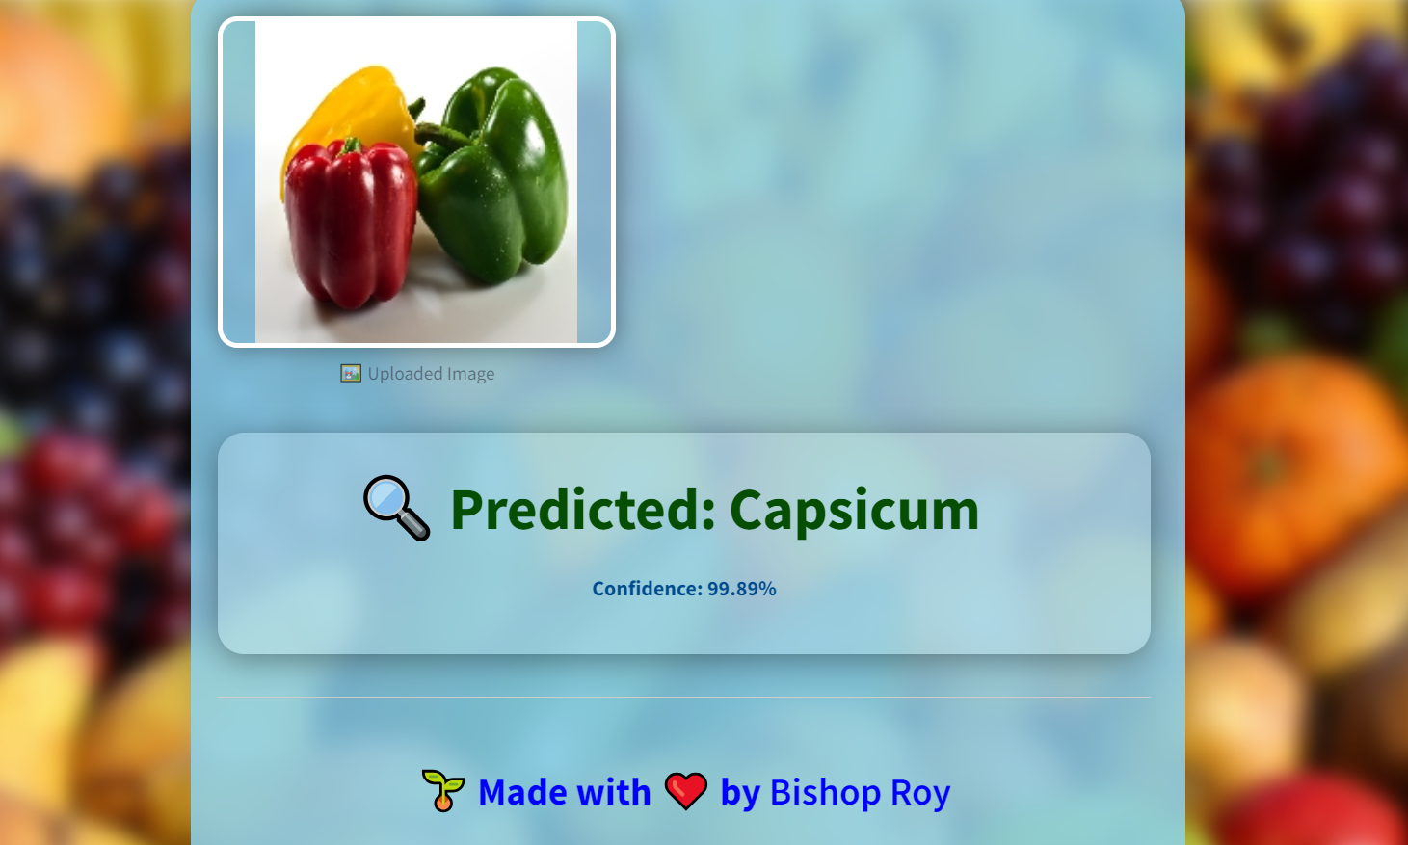
Demo Prediction
Input: Capsicum.jpg
Output: Predicted = Capsicum
Confidence = 99.89%

Slide 9
Deployment Workflow
Train CNN model → Save as .keras
Build UI with StreamLit
Upload image & get prediction
Real-time feedback

Slide 10

Future Improvements
Add more classes (leafy veggies, exotic fruits)
Build mobile version
Add voice support
Integrate real-time camera input

Slide 11

Conclusion
CNN-based classifier for fruits & vegetables
User-friendly StreamLit web app
Real-world usage in agriculture, education, retail

Slide 12

Thank You
Thank you for your attention!
Contact: 01775755766
arbishop@gmail.com
https://github.com/bishop-roy/Deep-Laerning

